Slide 1
Amazon SALES ANALYSIS
Project Report By
Pragnya

Slide 2
Project details
Project Title | Analysing Amazon Sales data
Technologies | Data Science
Domain | E-commerce
Project Difficulties Level | Advanced

Slide 3
objective
The objective of this project is to analyse Amazon sales data to identify trends and key metrics over time, such as month-wise, year-wise, and yearly trends. Additionally, the project aims to uncover meaningful relationships between various attributes to provide actionable insights for improving sales performance and cost management.

Slide 4
PROBLEM STATEMENT
Sales management has gained importance to meet increasing competition and the need for improved methods of distribution to reduce cost and to increase profits. Sales management today is the most important function in a commercial and business enterprise. Do ETL: Extract-Transform-Load some Amazon dataset and find for me Sales-trend > month-wise, year-wise, yearly-month-wise. Find key metrics and factors and show the meaningful relationships between attributes. Do your own research and come up with your findings.

Slide 5
Architecture
Raw Data Collection
Importing Libraries In Jupyter Notebook
Load Dataset
Missing Values Imputation
Handling Outliers
Data Pre-Processing
Report
Data Cleaning
Insight
PowerBi
Desktop
Exploratory Data Analysis (EDA)

Slide 6
Dataset Information
The dataset contains Amazon sales data, covering multiple years and months, with detailed records on product categories, regions, and financial metrics such as total cost, revenue, and profit. It was used to analyze sales trends, identify key metrics, and reveal relationships between various attributes for strategic decision-making.

Slide 7
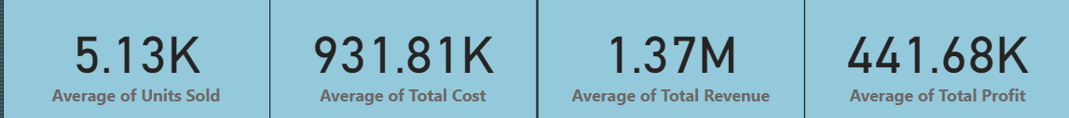
Average of Units Sold, Total Cost, Total Revenue, and Total Profit:
The report’s summary metrics provide a quick snapshot of the business’s overall performance.
The average units sold are 5.13K, suggesting a steady volume of sales.
The average total cost is 931.81K, which when compared with the average total revenue of 1.37M, shows that the company has a healthy profit margin.
The average total profit of 441.68K indicates a positive outcome, but there might be opportunities to reduce costs further to increase this profit margin.

Slide 8
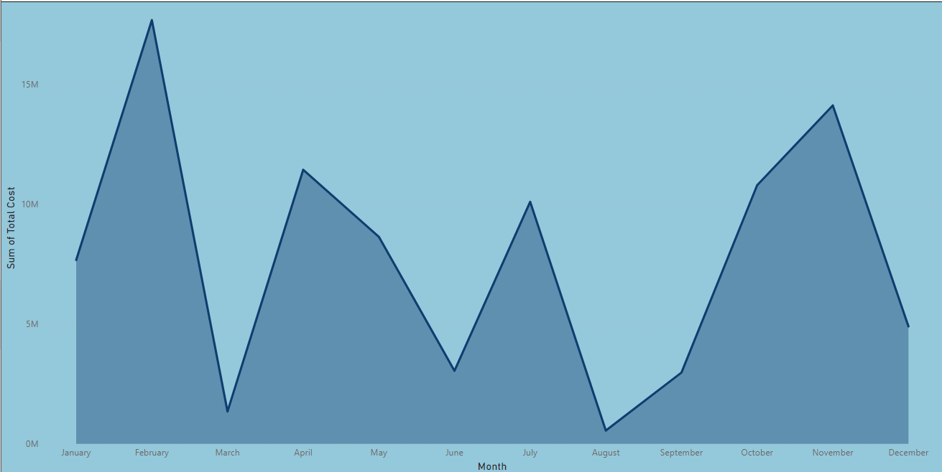
Total Cost by Month:
This line chart reveals that certain months, such as February, August, and December, see higher total costs, likely due to increased sales activity during these periods.
The sharp peaks in these months suggest seasonality effects or promotional events that drive up costs.

Slide 9
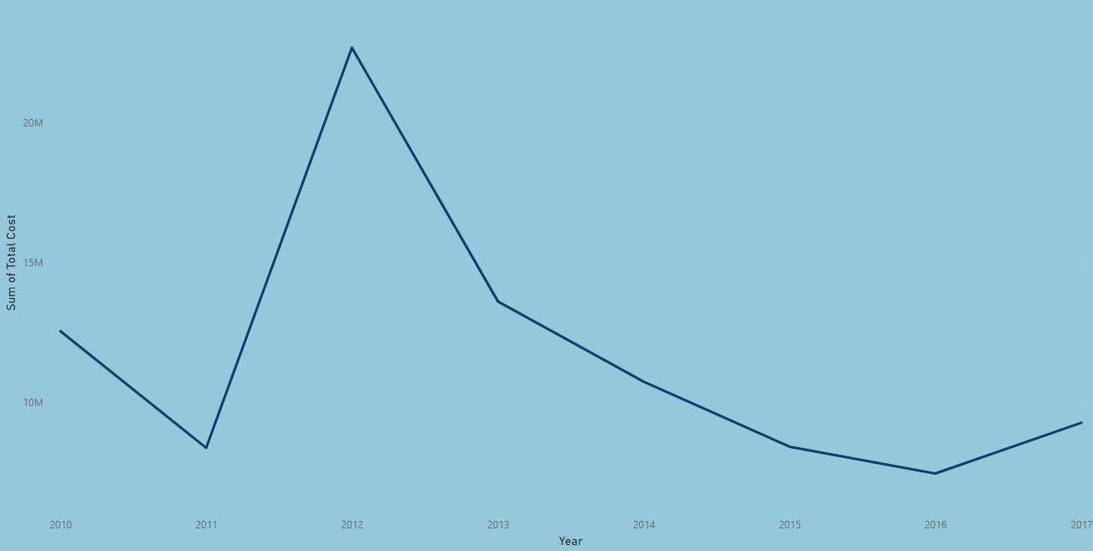
Total Cost per Year:
This line graph displays the trend of total costs over the years, revealing fluctuations in spending.
There is a noticeable increase in costs around 2012, followed by a peak in 2014. This might suggest significant investments or expansions during these years.
After 2014, there is a steady decline in total costs, which could indicate successful cost-cutting measures or a shift in the company’s strategy towards more efficient operations.

Slide 10
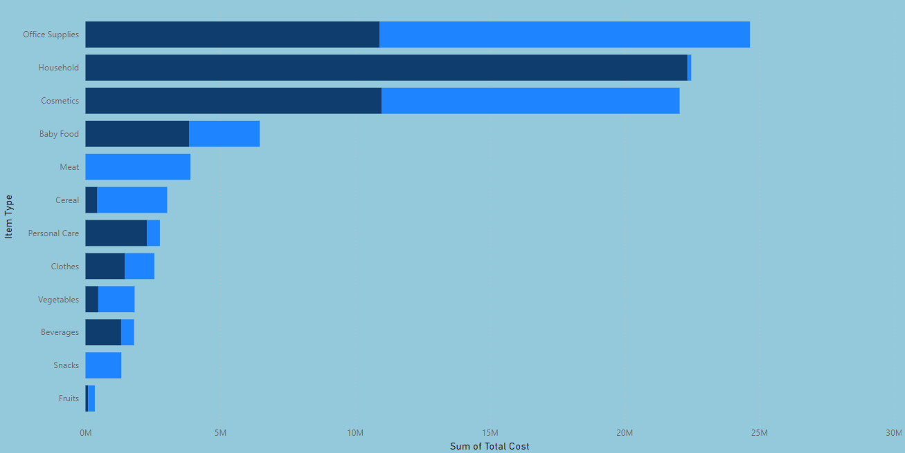
Total Cost of Item per Sales Channel:
Office Supplies and Household items incur the highest costs, indicating they are either more popular among customers or have higher procurement and handling expenses.
This chart helps identify where the majority of spending occurs across different product categories.

Slide 11
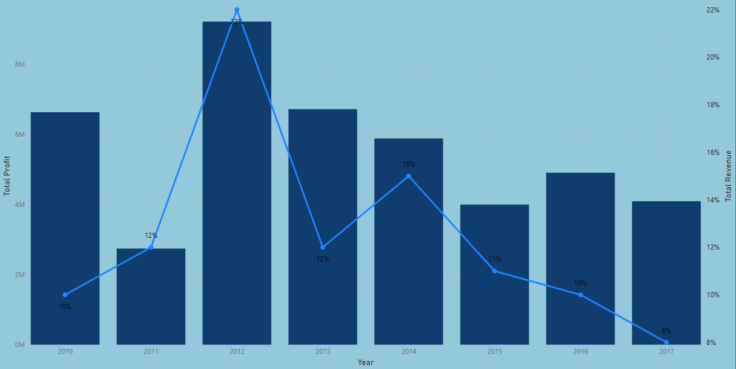
Total Profit and Total Revenue Year Wise:
The bar and line chart combination shows that 2012 was the most profitable year, with a significant spike in both profit and revenue.
However, there is a noticeable decline in profit percentages in the years following 2012, signalling potential challenges such as rising costs, market competition, or other operational inefficiencies.

Slide 12
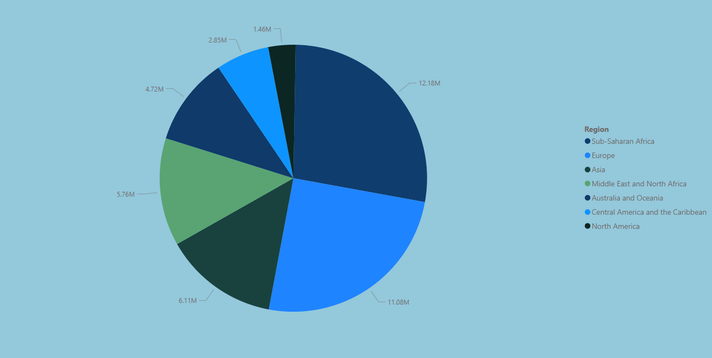
Total Profit by Region:
The pie chart indicates that Europe and Asia are the primary profit-generating regions, followed by North America.
This distribution suggests that these regions are crucial markets for the business, potentially requiring more focused strategies to maintain or grow market share.

Slide 13
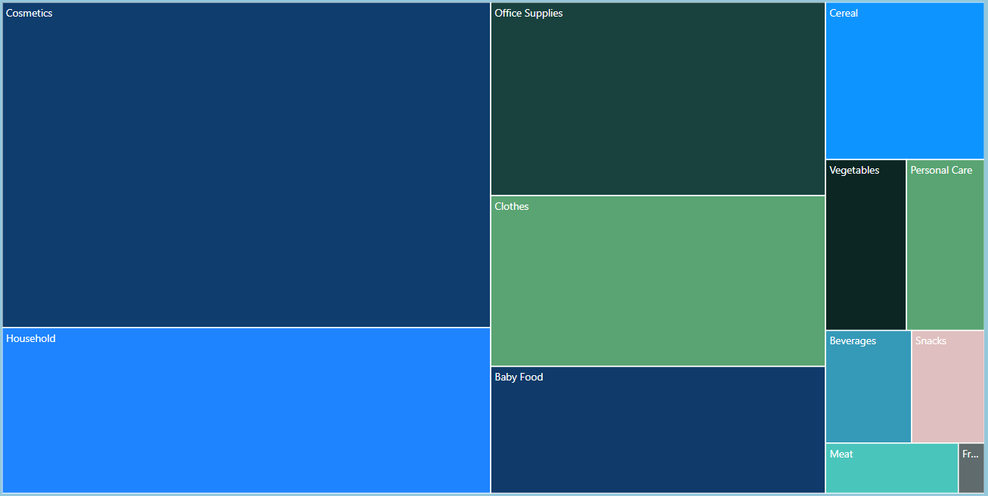
Total Profit by Item Type:
The tree map highlights that Cosmetics and Office Supplies are the top profit contributors, showing their strong performance in the market.
Categories like Baby Food and Household items also show significant contributions, suggesting a diversified portfolio that is well-received by consumers.

Slide 14
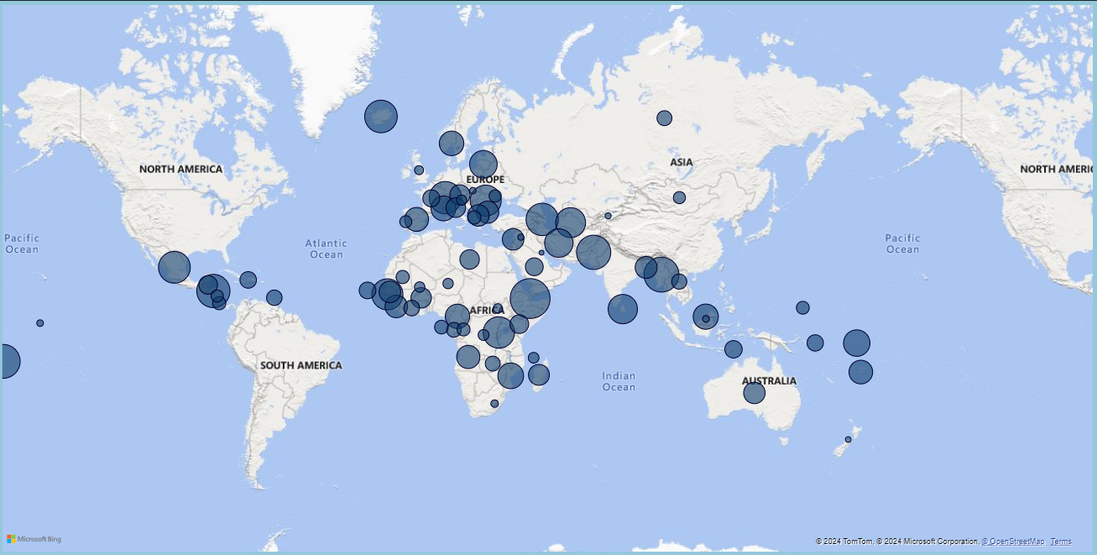
Sum of Total Profit by Country:
The map chart provides a geographical breakdown of profits, with key markets like the U.S., UK, and Germany standing out.
This visualization helps identify specific countries that are driving profits, which can be useful for strategic planning, including where to invest or where to improve marketing efforts.

Slide 15
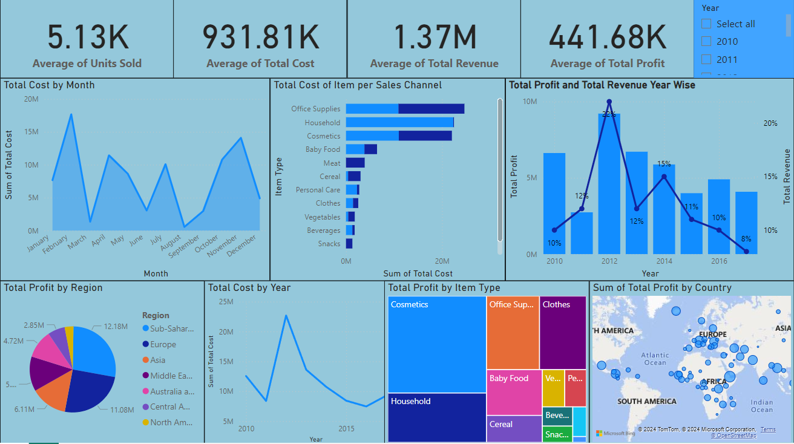
Report View

Slide 16
Conclusion
The project effectively analyzed Amazon sales data to identify key sales trends, costs, and profit metrics.
It revealed that 2014 was a peak year for costs, followed by successful cost management in subsequent years.
Geographical analysis highlighted Europe and Asia as the most profitable regions, with Cosmetics and Office Supplies leading in product profitability.
These insights will guide strategic decisions in market focus, product optimization, and cost management to enhance overall business growth and profitability.

Slide 17
THANK YOU

